Slide 1
Structures in C

Slide 2
Outline
Structure
Definition of structures Creating structures in C
dot operator, printf, scanf used for structure
typedef vs struct
Problem solving with structure (similar type) Problem solving with structure (dissimilar type) Passing structure as function parameter
Arrays of structure
Passing array of structure as function parameter Determining size of structure

Slide 3
Objectives
Be able to use compound data structures in programs
Be able to use arrays of compound data structures
Be able to pass compound data structures as function arguments
Be able to pass array of compound data structures as function arguments
3

Slide 4
Outline
Structure
Definition of structures Creating structures in C
dot operator, printf, scanf used for structure
typedef vs struct
Problem solving with structure (similar type) Problem solving with structure (dissimilar type) Passing structure as function parameter
Arrays of structure
Passing array of structure as function parameter Determining size of structure

Slide 5
Structures
Arrays require that all elements be of the same data type.
Many times it is necessary to group information of different data types
An example is a student list for a course (list typically includes several students info including a name, an id number, a mark, and a grade for each student)
C supports data structures that can store combinations of character, integer, float and double
They are called a struct.
5

Slide 6
Structure: Formal Definition
A structure is a compound data type that consists of two or more variables of similar or dissimilar primitive data types.
The variables are called members of the structure.
The structure is also called user-defined data types.
Later on we will see that a structure may contain even compound data types (i.e., structure within structure).
6

Slide 7
Outline
Structure
Definition of structures Creating structures in C
dot operator, printf, scanf used for structure
typedef vs struct
Problem solving with structure (similar type) Problem solving with structure (dissimilar type) Passing structure as function parameter
Arrays of structure
Passing array of structure as function parameter Determining size of structure

Slide 8
Defining Structures
Compound data:
typedef struct {
int int int
} ADate;
month; day; year;
A date is
an int month and
an int day and
an int year
month
day year
char | 1 | Byte
int | 4 | Bytes
float | 4 | Bytes
double | 8 | Bytes
ADate | 12 | Bytes
ADate
8

Slide 9


Defining Structures
Compound data:
typedef struct {
int int int
} ADate;
month; day; year;
A date is
an int month and
an int day and
an int year
int main(){
int x;
ADate d,p;
d.month = 1;
d.day = 18;
d.year = 2018; printf(“%d”, d.day);
printf(“%d”, d.month);
printf(“%d”, d.year); return 0;
}
9
month = 1;
day = 18;
year = 2018;

Slide 10
Outline
Structure
Definition of structures Creating structures in C
dot operator, printf, scanf used for structure
typedef vs struct
Problem solving with structure (similar type) Problem solving with structure (dissimilar type) Passing structure as function parameter
Arrays of structure
Passing array of structure as function parameter Determining size of structure

Slide 11
typedef
typedef struct {
member-list
} type-name;
typedef struct {
int month; int day;
int year;
}Date;
int main(){
Date date; date.month = 1;
date.day = 18;
date.year = 2018;
return 0;
}
11

Slide 12
struct
struct tag {
member-list
} variable-list;
struct ADate{
int month; int day;
int year;
};
int main(){
struct ADate date; date.month = 1;
date.day = 18;
date.year = 2018;
return 0;
}
12

Slide 13
Outline
Structure
Definition of structures Creating structures in C
dot operator, printf, scanf used for structure
typedef vs struct
Problem solving with structure (similar type) Problem solving with structure (dissimilar type) Passing structure as function parameter
Arrays of structure
Passing array of structure as function parameter Determining size of structure

Slide 14
Question
Write down a program that defines a structure to store x and y coordinates of a point in 2- dimensional space. Then take x, y coordinates of TWO points as user input and find Euclidian distance between them.
14

Slide 15
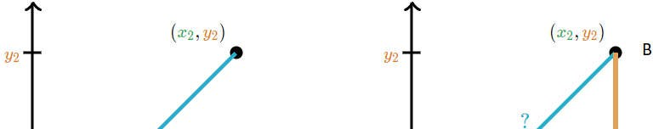
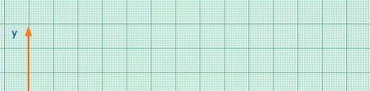
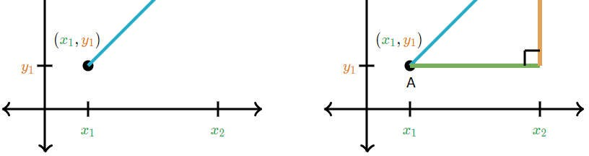
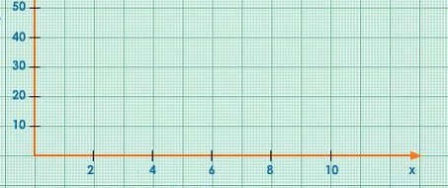
Euclidian distance
15

Slide 16
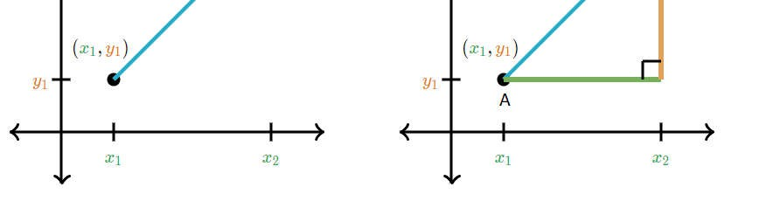

Euclidian distance
d =
dy
dx
d =
16

Slide 17
Problem at a glance
P(x₁, y₁)
Your Program
E.D.
Q(x₂, y₂)
17

Slide 18
Solution: Defining Structure
Compound data:
typedef struct {
int x;
int y;
} Point;
A Point is
an int x coordinate and
an int y coordinate
x
y
char int
float double
Point
1 Byte
4 Bytes
4 Bytes
8 Bytes
8 Bytes
Point
18

Slide 19
Solution: logic
Compound data:
typedef struct {
int x;
int y;
A Point is
} Point;
an int x coordinate and _{int main(){}
an int y coordinate
int x,dx,dy; float d; Point p,q;
p.x | = | 1;
p.y | = | 2;
q.x | = | 4;
q.y | = | 5;
x = 1;
y = 2;
dx = p.x - q.x;
dy = p.y - q.y;
d = dx*dx + dy*dy; d = sqrt(d);
printf(“E.D. %f”,d); return 0;
}
19

Slide 20
Input from users
Compound data:
typedef struct {
int x;
int y;
A Point is
} Point;
an int x coordinate and _{int main(){}
an int y coordinate
int x,dx,dy;
float Point | d; p,q;
p.x = | 1; | scanf(“%d”,&p.x);
p.y = | 2; | scanf(“%d”,&p.y);
q.x = | 4; | scanf(“%d”,&q.x);
q.y = | 5; | scanf(“%d”,&q.y);
dx = p.x - q.x;
dy = p.y - q.y;
d = dx*dx + dy*dy; d = sqrt(d);
printf(“E.D. %f”,d); return 0;
}
20

Slide 21
Outline
Structure
Definition of structures Creating structures in C
dot operator, printf, scanf used for structure
typedef vs struct
Problem solving with structure (similar type) Problem solving with structure (dissimilar type) Passing structure as function parameter
Arrays of structure
Passing array of structure as function parameter Determining size of structure

Slide 22
Question
Create a structure named Student that has
name, roll, mark and grade as members. Assume appropriate types and size of member. Write a program using structure to read and display the data entered by the user. Find his/her grade using a user- defined function.
22

Slide 23
Solution: Defining Structure
Compound data: A Student has
a char n[50] name
an int id student id
a float m mark and
a char g grade
typedef struct { char n[50];
int id; float m; char g;
} Student;
n
id m
g
char | 1 | Byte
int | 4 | Bytes
float | 4 | Bytes
double | 8 | Bytes
Student
Student
59 Bytes
23

Slide 24
Solution: Defining Structure
typedef struct { char n[50]; int id; float m;
char g;
} Student; int main(){
Student s; printf(“Name: “); gets(s.n); printf(“ID: ”);
scanf(“%d”,&s.id);
printf(“Mark: “);
scanf(“%f”,&s.m);
s.g = findGrade(s); printf(“%s %d %f %c”, s.n,
s.id, s.m, s.g);
return 0;
24
Compound data: A Student has
a char n[50] name
an int id student id
a float m mark and
a char g grade
char findGrade(Student s){ char g;
if(s.m >= 90) g = ‘A’;
else | if(s.m | >= | 80) | g | = | ‘B’;
else | if(s.m | >= | 70) | g | = | ‘C’;
else | if(s.m | >= | 60) | g | = | ‘D’;
else g = ‘F’; return g;
}
}

Slide 25
How to store info of many students?
Suppose we want to keep record of 100 students,
-we have to make 100 structure variables like s1, s2, …,s100.
In this situation we can use array of structure to store the records of 100 students which is easier and efficient to handle (because loops can be used).
25

Slide 26
Outline
Structure
Definition of structures Creating structures in C
dot operator, printf, scanf used for structure
typedef vs struct
Problem solving with structure (similar type) Problem solving with structure (dissimilar type) Passing structure as function parameter
Arrays of structure
Passing array of structure as function parameter Determining size of structure

Slide 27
Question
Write down
a program that defines a
structure to store a student’s information in a university. Then take 5 students’ information as user input and find grade of each student using a user defined function
27

Slide 28
Solution
typedef struct { char n[50]; int id;
Compound data: A Student has
a char n[50] name
an int id student id
a float m mark and
a char g grade
float m; char g;
}Student; int main(){
Student s[5]; int i;
for(i = 0; i < 5; i++){ printf(“Name: “);
gets(s[i].n);
printf(“ID: ”); scanf(“%d”,&s[i].id); printf(“Mark: “); scanf(“%f”,&s[i].m);
s[i].g = findGrade(s[i]);
printf(“%d %f %c”, s[i].id,
char findGrade(Student s){ char g;
if(s.m >= 90) g = ‘A’;
else | if(s.m | >= | 80) | g | = | ‘B’;
else | if(s.m | >= | 70) | g | = | ‘C’;
else | if(s.m | >= | 60) | g | = | ‘D’;
else g = ‘F’; return g;
}
s[i].m, s[i].g); return 0; }
28

Slide 29
Question
Write down a program that defines a structure to store a student’s information in a university. Then taken N students’ information as user input and find grade of each student using a user defined function. N will also be input.
29

Slide 30
Solution
typedef struct { char n[50]; int id;
Compound data: A Student has
a char n[50] name
an int id student id
a float m mark and
a char g grade
float m; char g;
} Student; int main(){
int i;
int i, N;
scanf(“%d”,&N); Student s[N];
char findGrade(Student s){ char g;
if(s.m >= 90) g = ‘A’;
Student s[5];
for(i = 0; i < 5; i++){ printf(“Name: “);
gets(s[i].name);
printf(“ID: ”); scanf(“%d”,&s[i].id); printf(“Mark: “); scanf(“%f”,&s[i].m);
s[i].g = findGrade(s[i]);
printf(“%d %f %c”, s[i].id,
else | if(s.m | >= | 80) | g | = | ‘B’;
else | if(s.m | >= | 70) | g | = | ‘C’;
else | if(s.m | >= | 60) | g | = | ‘D’;
else g = ‘F’; return g;
}
s[i].m, s[i].g); return 0; }
30

Slide 31
Solution
typedef struct { char n[50]; int id; float m;
char g;
} Student; int main(){
Compound data: A Student has
a char n[50] name
an int id student id
a float m mark and
a char g grade
int i, N;
scanf(“%d”,&N); Student s[N];
char findGrade(Student s){ char g;
if(s.m >= 90) g = ‘A’;
for(i = 0; i < N; i++){ printf(“Name: “);
gets(s[i].n);
printf(“ID: ”); scanf(“%d”,&s[i].id); printf(“Mark: “); scanf(“%f”,&s[i].m);
s[i].g = findGrade(s[i]);
printf(“%d %f %c”, s[i].id,
else | if(s.m | >= | 80) | g | = | ‘B’;
else | if(s.m | >= | 70) | g | = | ‘C’;
else | if(s.m | >= | 60) | g | = | ‘D’;
else g = ‘F’; return g;
}
s[i].m, s[i].g); return 0; }
31

Slide 32
Outline
Structure
Definition of structures Creating structures in C
dot operator, printf, scanf used for structure
typedef vs struct
Problem solving with structure (similar type) Problem solving with structure (dissimilar type) Passing structure as function parameter
Arrays of structure
Passing array of structure as function parameter Determining size of structure

Slide 33
Question
Write down a program that defines a structure to store a student’s information in a university. Then taken N students’ information as user input and find average mark using a user defined function. N will also be input.
33

Slide 34
Solution
typedef struct { char n[50]; int id; float m;
char g;
}Student; int main(){
int i, N; float avg; scanf(“%d”,&N); Student s[N];
for(i = 0; i < N; i++){ printf(“Name: “);
gets(s[i].n);
printf(“ID: ”); scanf(“%d”,&s[i].id); printf(“Mark: “); scanf(“%f”,&s[i].m); avg = average(s, N);
printf(“Average %f”, avg); return 0; }
Compound data:
A Student has
a char n[50] name
an int id student id
a float m mark and
a char g grade
float average(Student s[], int N)
{
float sum=0,avg; int i;
for(i = 0; i < N; i++) sum = sum + s[i].m;
avg = sum/N; return avg;
}
34

